Slide 1
Teen 9Up Java - 01
Teen MAN

Slide 2
JAVA Project Structure
Package
src model view controller main Application.java test TestApplication.java
Where the program gets started

Slide 3
MAIN FUNCTION
Only one main function in a program
Where the program gets started
public class ApplicationName { public static void main(String[] args){ //Do sth } }
*** Don’t ask me why the main function looks like this, it is a standard even thought I can explain it in details.

Slide 4
Function structure
<accessibility> <return type> <functionName> ( <paramaters> ) {}
public int Sum(int p1, int p2){
return p1+p2;
}
public void Sum(String p1){ //void = no return value
//logic
}

Slide 5
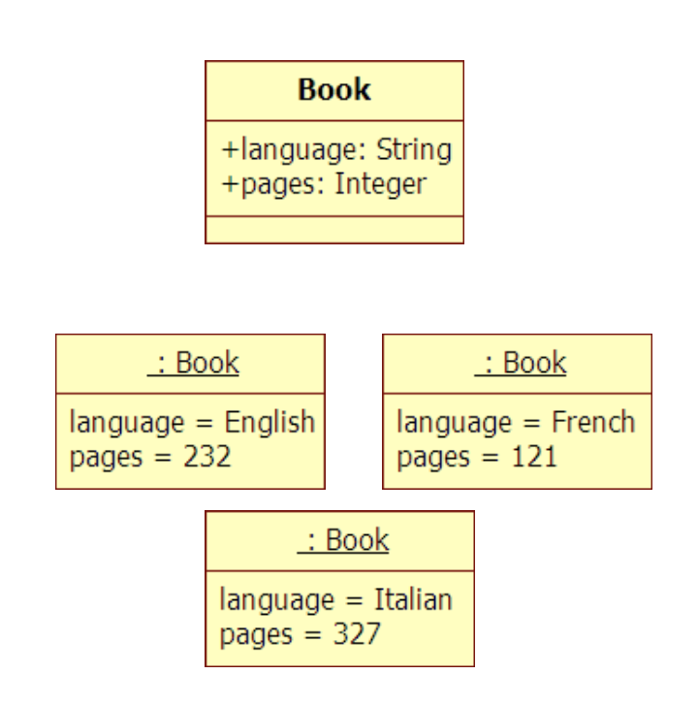
Class VS Object
class
Simply speaking, if your object is a book, class is a book definition and the maker. If your object is a HKID card, class is a HKID card definition (class) and the maker (constructor), like immigration dept
objects

Slide 6
Class
If your object is a HKID card, class is a HKID card definition and the maker, like immigration dept
Immigration dept has to define the standard of a HKID card - Attributes (e.g. id#, name, dob) - data types (e.g. string, int, float) - accessibility (e.g. public, private, protected) - functions (e.g. borrow books in public library) (properly abstract, only definition, no implementation logic)
Notes:
If your object is a book, than class is a book maker.
If your object is a HKID card, than class is a HKID card maker, like immigration dept
Immigration dept has to defind the standard of a HKID card
- attributes (e.g. id#, name, dob)
- data types (e.g. string, int, float)
- functions (propertly abstract, only definition, no implementation logic) (e.g. borrow bookes in public library)
public VS private
public: name, dob: you can see them in the card
biometric data, like footprint: you need a reader to read

Slide 7
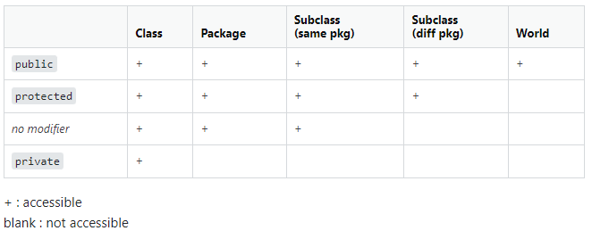
How to define a Class
Public
Private
Protected
name, dob (you can see them in the card)
In Java, object.name, object.dob
biometric data, like footprint -> you need a reader to read the information
In Java, we need getter and setter
Self-study la. Rarely use protected

Slide 8
How to define a Class
class Book {
public String name; public String author: private String language; //declare class attributes as private private int pages; //provide public get and set methods to access and update the value of a private attributes
public void setName(String name){
this.name = name;
}
public String getName(){
return this.name;
}
}

Slide 9
How to Create an object - Constructor
class Book {
public String name;
private String author;
public String language; //declare class attributes as private
public int pages; //provide public get and set methods to access and update the value of a private attributes
public void setAuthor(String author){
this. author = author;
}
public String getAuthor (){
return this.author;
}
}
/*
//Default Constructor
public Book() {}
*/
//Self-defined Constructor
public Book(String name, String author, String language, int pages) {
this.name = name; this.author = author;
this. language = UPPER(language);
this. pages = pages;
}

Slide 10
How to Create an object - Constructor
package xxx;
import Book; //assume Book is under same level in the project
public class PublishBooks{
public static void main(String args[]){
Book book1 =new Book(); //using the default constructor
Book book2 = new Book(“Coding is fun”, “Nerdy Programmer”, “English”, 10); // to update private attributes in a book object book1.setAuthor(“Eddie Redmayne”);
}
}

Slide 11
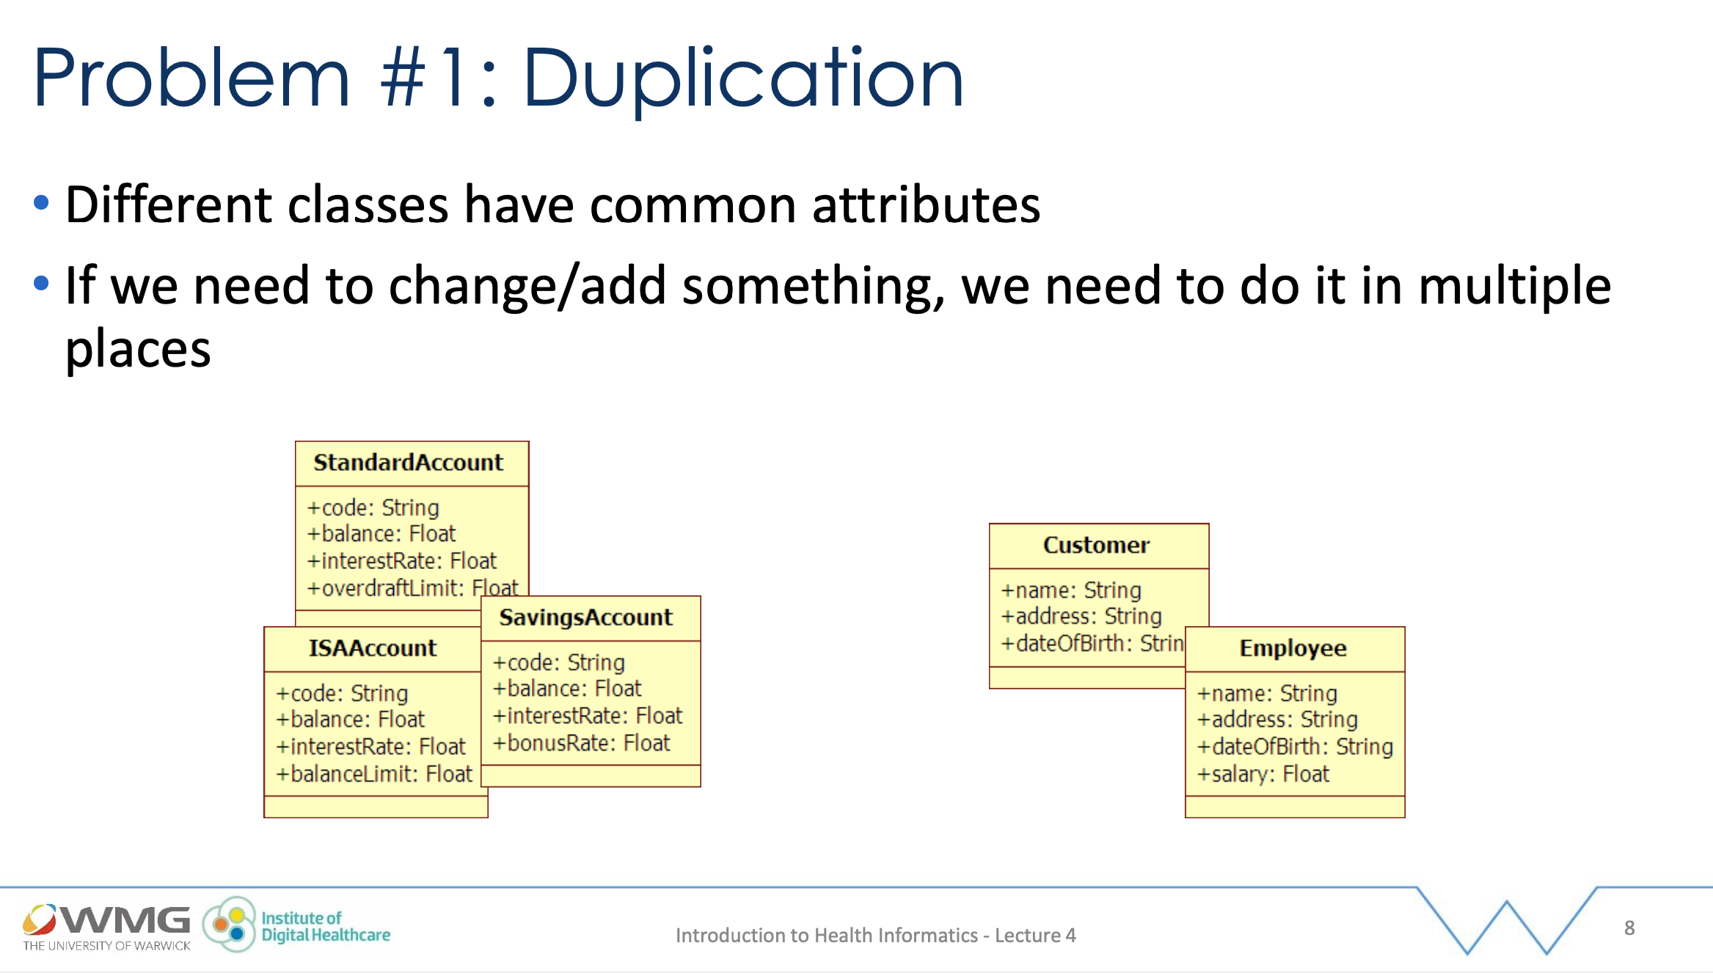

Slide 12
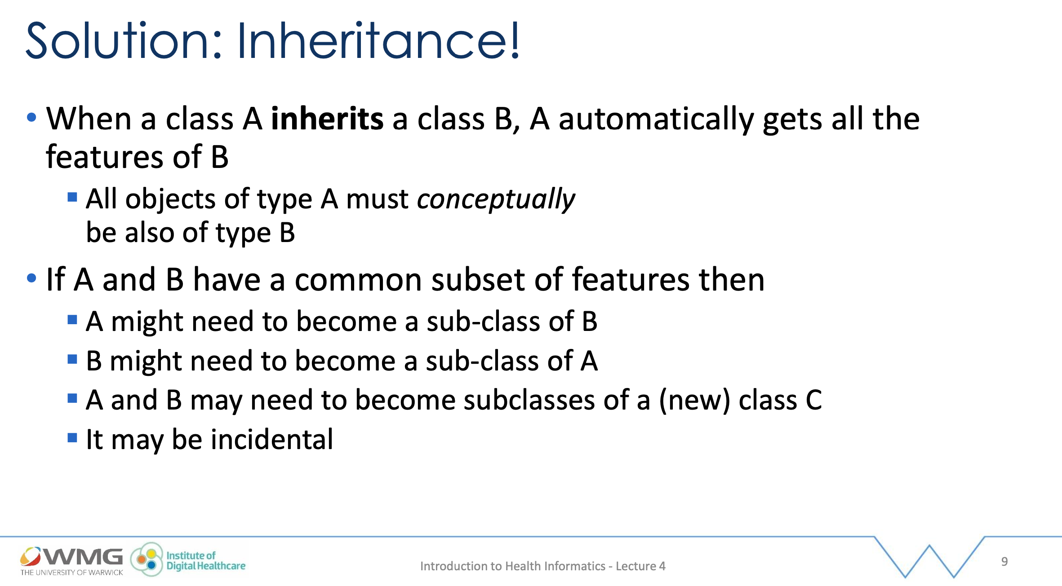

Slide 13
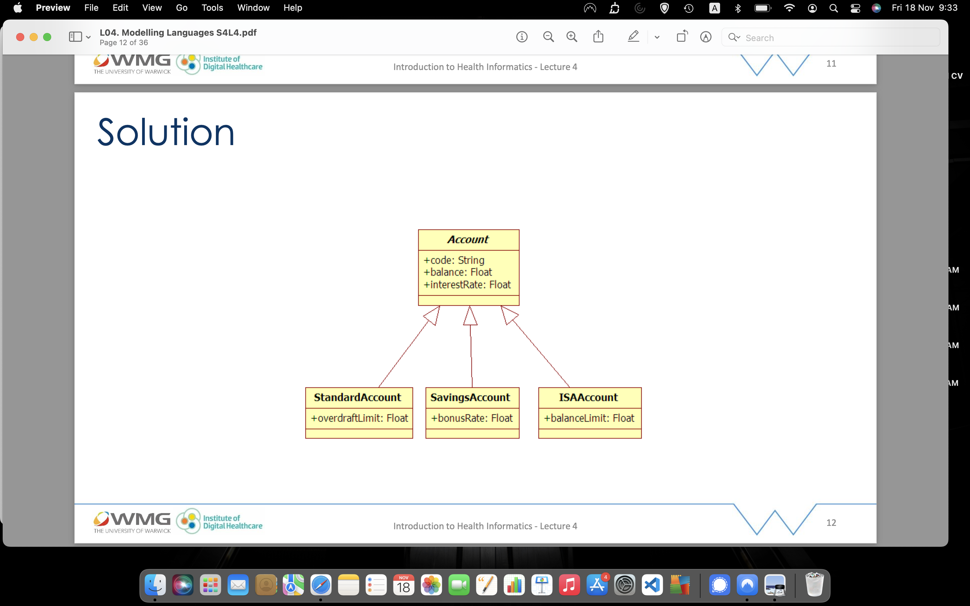
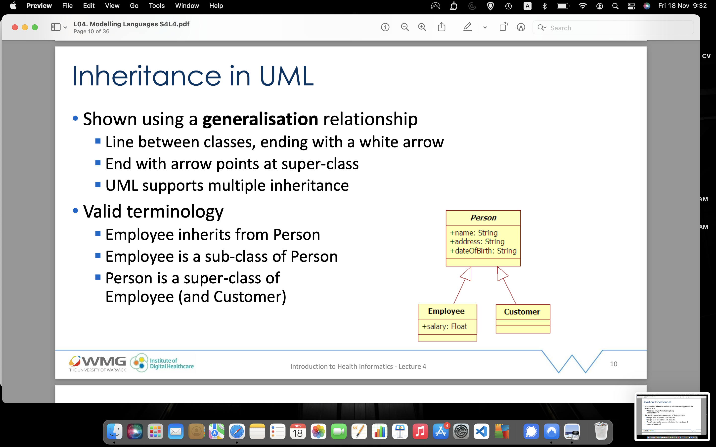
SUPERClass and subclass (extends)
superclass
(EXTENDS)
subclass

Slide 14
Class and subclass (extends)
class Person {
private String name; //declare class variables/attributes as private
private String address;
private Date dob;
//Defined Constructor
public Person(String name, String address, Date dob) {
this.name = name;
this.address = address;
this.dob = dob;
}
public void setName(String name){ //provide public get and set methods to access and update the value of a private variable
this.name = name;
}
public String getName(){
return this.name;
}
}
class Employee extends Person {
private float salary;
//constructor
public Employee(String name, String address, Date dob, float salary) {
super();
//super(name, address, dob);
this.salary = salary;
}
public void setSalary(float salary){
this.salary = salary;
}
public float getSalary(){
return this.salary;
}
}

Slide 15
Class and subclass (extends)
package xxx;
import Employee;
import java.util.Date;
public Main{
// main
public static void main(String args[]){
Employee e=new Employee("Chan Siu Ming, "Hong Kong", new Date() , 1500.5);
System.out.println("(public) " + e.name);
System.out.println("(private) " + e.getSalary());
}
}

Slide 16
Abstract class, Interface
Abstract class: is a restricted class that cannot be used to create objects (to access it, it must be inherited from another class).
Abstract method: can only be used in an abstract class, and it does not have a body. The body is provided by the subclass (inherited from).
An interface is a completely "abstract class" that is used to group related methods with empty bodies:

Slide 17
Implement logic in abstract classes Implement, override
interface Listener {
void listen(Event event);
}
class TigerListener implements Listener {
@Overrides
void listen(Event event) {
if (event instanceof GrowlEvent) {
//handle growl...
}
else if (event instance of MeowEvent) {
//handle meow
}
//we don't care about any other types of Events
}
}

